Slide 1






Creating Connections & Touch Points
SLED 2025

Slide 2

Session Overview
  Introduction to Connections & Community
  Informal Touch Points
  Assessing Needs
  Students of Concern
  Forms and Communication
  Follow Through

Slide 3
COMMUNITY

Slide 4
Caring
Safe
Intentional
Connected
COMMUNITY
Comfortable
Welcoming
Empowering
Inclusive

Slide 5
How can we practice and implement these values as community leaders?

Slide 6
Building Connections
  Can be structured or unstructured
  Should be consistent and re-enforced
  Require you to be engaged
  Can be fun, but may also be more serious in nature

Slide 7

Tommie Advantage
Events
1 : 1 s
Community Communications
Community Meetings

Slide 8

Informal Touch Points
  Connection that is not scripted or formalized but IS individualized
  Connection that is still intentional
  Perceptive and engaged
  Focused on building or maintaining connection

Slide 9
Knocking on doors to say hello
Making conversation in floor GroupMe
Inviting residents to meals
Examples of Informal Touch Points
Doing homework in the community lounge
Hosting game nights

Slide 10
Why do you think informal touch points are important?
Think, Pair, Share

Slide 11
Purpose
  Belonging and Inclusion
  Building rapport
  Create opportunities
  Follow-through as community leaders
  Assessing needs

Slide 12
How do you know what your residents need?

Slide 13
Assessing Needs
  Regularly check-in with residents
  Ask questions with intention
  Pay attention to who you are or are not seeing around the hall
  Follow-up on concerns or issues voiced
  Communicate concerns with CD/GSA
  Seek feedback from residents

Slide 14
Students of Concern
  There are a variety of concerns that may come up when engaging with residents
  Examples
    Homesickness
    Considering transferring
    Sense of belonging in general
    Financial concerns
    Struggling to make friends
    Academics
    Family emergencies/concerns

Slide 15
What do you do with this information?

Slide 16
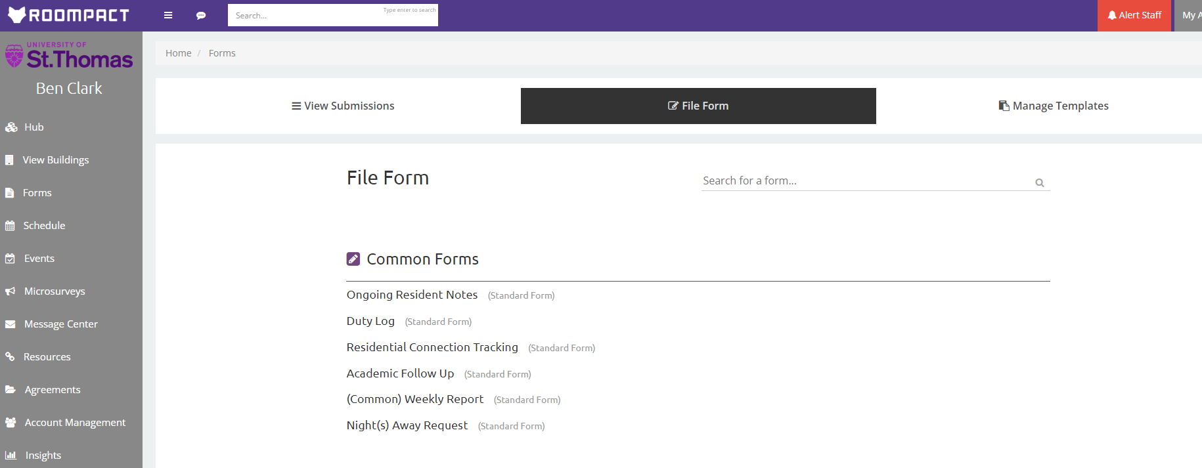

Complete an Ongoing Resident Note

Slide 17
Ongoing Resident Notes
  Resident name
  Your name
  Date of behavior
  Behaviors notes
  Concerns
  What has already happened in response?
  What offices or resources have you already referred the student to?
  What follow up/next steps do you recommend?

Slide 18
Purpose
  Keeps your supervisor informed and they can then help provide guidance on how to move forward
  Helps us provide individualized care to each student
  Creates opportunities to get connected to resources in a timely manner

Slide 19
Final Considerations
  You are a leader in the community, role model the connections you want to see
  Curiosity shows you care
  It is okay to set boundaries
  You always have someone to lean on for support

Slide 20
Scenario #1
  During your first 1:1 conversation with a resident they share with you that they have been struggling to find community and connection since coming to St. Thomas. Initially, they were close friends with their roommates but now they seem to just co-exist in the space together. Their roommate frequently has friends over and they feel left out and don’t know how to find their own community.
    Where would you start?
    What would be more applicable, a formal or informal touch point?
    What would that touch point look like?
    What follow up steps would you consider taking?

Slide 21
Scenario #2
  Your resident continually finds you while you are on duty and overstays their welcome at the desk or in your room. They state that they were extremely involved in high school sports and really miss the friends that they had from a team. They have expressed an interest in getting involved on campus but don’t know where to start and asked if you could help them figure out the next step.
    Where would you start?
    What would be more applicable, a formal or informal touch point?
    What would that touch point look like?
    What follow up steps would you consider taking?

Slide 22
Scenario #3
  Your supervisor emails you to inform you that they have been trying to get in touch with one of your residents because their professor reached out to the Dean of Student’s Office expressing concern for their mental well-being. Your supervisor has attempted to knock on their door and call them, but they haven’t responded. Your supervisor asks you to connect with your resident to assist in getting them connected to resources and responding to outreach attempts.
    Where would you start?
    What would be more applicable, a formal or informal touch point?
    What would that touch point look like?
    What follow up steps would you consider taking?

Slide 23
Questions?

